Slide 1
Modeling with UML

Slide 2
Systems
A system is an organized set of communicating parts
  Natural system: A system whose ultimate purpose is may not be known
  Engineered system: A system which is designed and built by engineers for a specific purpose
The parts of the system can be considered as systems again
  In this case we call them subsystems
Examples of natural systems: Universe, earth, ocean
Examples of engineered systems: Airplane, watch, GPS
Examples of subsystems: Jet engine, battery, satellite.

Slide 3
Systems, Models and Views
A model is an abstraction describing a system or a subsystem
A view depicts selected aspects of a model
A notation is a set of graphical or textual rules for depicting models and views
System: Airplane
Models: Flight simulator, Scale model
Views:
Blueprint of the airplane components
Electrical wiring diagram, Fuel system
Notes:
A view is a subset of a model that makes it more understandable
All the blueprints needed to build a scale model are a view of the scale model.
The film shows a flyby of a F-14 airplane at an aircraft carrier reaching supersonic speed. The sound wave can be well seen.

Slide 4
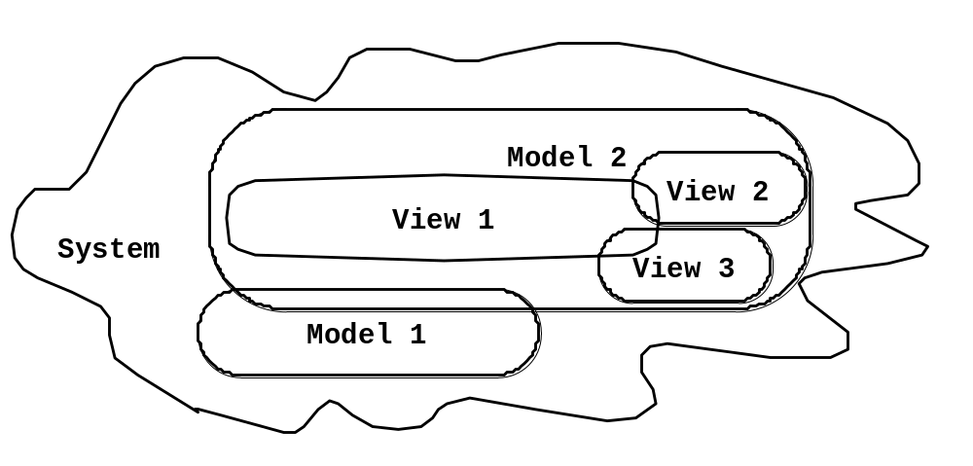
Systems, Models and Views
(“Napkin” Notation)
Flightsimulator
Aircraft
Fuel System
Blueprints
Electrical
Wiring
Scale Model
Views and models of a complex system usually overlap
Notes:
This is a graphical notation of a system.
We show the systems and subsystems as areas, and annotate them with clouds containing the name of the system.
It is important to notice that we use this type of notation in many situations, we might write it down in the sand on the beach, we might use a napkin in a restaurant.
It is a conceptual description of the system, using a freeformat notation.
For this reason I call it the napkin notation

Slide 5

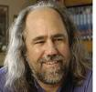


What is UML? Unified Modeling Language
Convergence of different notations used in object-oriented methods, mainly - OMT (James Rumbaugh and collegues), OOSE (Ivar Jacobson), Booch (Grady Booch)
They also developed the Rational Unified Process, which became the Unified Process in 1999
Developed the Booch method (“clouds”), ACM Fellow 1995, and IBM Fellow 2003
http://www.booch.com/
25 year at GE Research, where he developed OMT, joined (IBM) Rational in 1994, CASE tool OMTool
At Ericsson until 1994, developed use cases and the CASE tool Objectory, at IBM Rational since 1995, http://www.ivarjacobson.com

Slide 6
What is UML?
UML (Unified Modeling Language)
  Nonproprietary standard for modeling software systems, OMG
  Convergence of notations used in object-oriented methods
    OMT (James Rumbaugh and collegues)
    Booch (Grady Booch)
    OOSE (Ivar Jacobson)
Current Version: UML 2.3
  Information at the OMG portal http://www.uml.org/
Commercial tools: Rational (IBM), Together (Borland), Visual Architect (business processes, BCD)
Open Source tools: ArgoUML, StarUML, Umbrello
Commercial and Opensource: PoseidonUML (Gentleware)

Slide 7
UML: First Pass
You can model 80% of most problems by using about 20% UML
We’ll learn those 20%

Slide 8
UML First Pass
Use case diagrams: Describe the functional behavior of the system as seen by the user
Class diagrams: Describe the static structure of the system: Objects, attributes, associations
Sequence diagrams: Describe the dynamic behavior between objects of the system
State chart diagrams: Describe the dynamic behavior of an individual object
Activity diagrams: Describe the dynamic behavior of a system, in particular the workflow.
Notes:
Statechart diagrams
Describe the dynamic behavior of an individual object (essentially a finite state automaton)
Activity Diagrams
Model the dynamic behavior of a system, in particular the workflow (essentially a flowchart)

Slide 9
UML Core Conventions
All UML Diagrams denote graphs of nodes and edges
  Nodes are entities and drawn as rectangles or ovals
  Rectangles denote classes or instances
  Ovals denote functions
Names of Classes are not underlined
  SimpleWatch
  Firefighter
Names of Instances are underlined
  myWatch:SimpleWatch
  Joe:Firefighter
An edge between two nodes denotes a relationship between the corresponding entities

Slide 10
UML Use Case Diagrams
Used during requirements elicitation and analysis to represent external behavior (“visible from the outside of the system”)
Passenger
An Actor represents a role, that is, a type of user of the system
A use case represents a class of functionality provided by the system
PurchaseTicket
Use case model:
  The set of all use cases that completely describe the functionality of the system.

Slide 11
Actors
An actor is a model for an external entity which interacts (communicates) with the system:
  User
  External system (Another system)
  Physical environment (e.g. Weather)
An actor has a unique name and an optional description
Examples:
  Passenger: A person in the train
  GPS satellite: An external system that provides the system with GPS coordinates.
Passenger
Optional
Description
Name

Slide 12
Use Case
• A use case represents a class of functionality provided by the system
• Use cases can be described textually, with a focus on the event flow between actor and system
• The textual use case description consists of 6 parts:
  Unique name
  Participating actors
  Entry conditions
  Exit conditions
  Flow of events
  Special requirements.
PurchaseTicket

Slide 13
Textual Use Case
Description Example
Passenger
PurchaseTicket
1. Name: Purchase ticket
2. Participating actor: Passenger
3. Entry condition:
Passenger stands in front of ticket distributor
Passenger has sufficient money to purchase ticket
4. Exit condition:
Passenger has ticket
5. Flow of events:
  1. Passenger selects the number of zones to be traveled
  2. Ticket Distributor displays the amount due
  3. Passenger inserts money, at least the amount due
  4. Ticket Distributor returns change
  5. Ticket Distributor issues ticket
6. Special requirements: None.
Notes:
Question: Anything missing? Answer: Exceptional cases!
Use cases represent functionality of the system
All use cases need to be described for the model to be useful
Use case diagrams are useful as an index into the use cases
The Textual Use case descriptions provide meat of model, not the use case diagrams.

Slide 14
UML first pass: Use case diagrams
Classifier
Use Case
Actor
System boundary
Use case diagrams represent the functionality of the system
from user’s point of view

Slide 15
Exercise: Use Case Diagram
Draw a Use Case diagram for a SimpleWatch. A user of the watch can read time and set time. The battery of the watch can be changed by a repair person.

Slide 16
Exercise: Use Case Diagram
Classifier
Use case
Watch
Actor
ReadTime
WatchUser
SetTime
WatchRepairPerson
ChangeBattery
Use case diagrams represent the functionality of the system
from user’s point of view

Slide 17
Uses Cases can be related
Extends Relationship
  To represent seldom invoked use cases or exceptional functionality
Includes Relationship
  To represent functional behavior common to more than one use case.

Slide 18
The <<extends>> Relationship
<<extends>> relationships model exceptional or seldom invoked cases
The exceptional event flows are factored out of the main event flow for clarity
The direction of an <<extends>> relationship is to the extended use case
Use cases representing exceptional flows can extend more than one use case.
Passenger
PurchaseTicket
<<extends>>
<<extends>>
<<extends>>
OutOfOrder
<<extends>>
TimeOut
Cancel
NoChange

Slide 19
The <<includes>> Relationship
<<includes>> relationship represents common functionality needed in more than one use case
<<includes>> behavior is factored out for reuse, not because it is an exception
The direction of a <<includes>> relationship is to the using use case (unlike the direction of the <<extends>> relationship).
Passenger
PurchaseMultiCard
PurchaseSingleTicket
<<includes>>
<<includes>>
<<extends>>
CollectMoney
<<extends>>
<<extends>>
NoChange
Cancel
Timeout

Slide 20
Class Diagrams
Class diagrams represent the structure of the system
Used
  during requirements analysis to model application domain concepts
  during system design to model subsystems
  during object design to specify the detailed behavior and attributes of classes.
TariffSchedule
Trip
Table zone2price
Enumeration getZones()
Price getPrice(Zone)
zone:Zone
price: Price
*
*

Slide 21
Classes
Type
TariffSchedule
Table zone2price
Enumeration getZones()
Price getPrice(Zone)
Name
TariffSchedule
Attributes
Signature
zone2price
getZones()
getPrice()
Operations
TariffSchedule
A class represents a concept
A class encapsulates state (attributes) and behavior (operations)
Each attribute has a type
Each operation has a signature
The class name is the only mandatory information

Slide 22
Instances
tariff2006:TariffSchedule
:TariffSchedule
zone2price = {
{‘1’, 0.20},
{‘2’, 0.40},
{‘3’, 0.60}}
zone2price = {
{‘1’, 0.20},
{‘2’, 0.40},
{‘3’, 0.60}}
An instance represents a phenomenon
The attributes are represented with their values
The name of an instance is underlined
The name can contain only the class name of the instance (anonymous instance)

Slide 23
Class vs. Object
Class
  An abstraction modeling an entity in the application or solution domain
  The class is part of the system model ( “Passenger”, “Ticket distributor”, “Server”, “TariffSchedule”)
Object
  A specific instance of a class (“Joe, the passenger who is purchasing a ticket from the ticket distributor”).
Notes:
What is the difference between an actor, a class and an instance?

Slide 24
Associations
TarifSchedule
TripLeg
Enumeration getZones()
Price getPrice(Zone)
*
Price
Zone
*
Associations denote relationships between classes.
The multiplicity of an association end denotes how many objects the instance of a class can legitimately reference.

Slide 25
1-to-1 and 1-to-many Associations
Country
1
1
CapitalCity
name:String
name:String
1-to-1 association
Point
Polygon
*
x: Integer
draw()
y: Integer
1-to-many association

Slide 26
Many-to-Many Associations
Company
*
*
StockExchange
tickerSymbol
Notes:
A stock exchange lists many companies each of them uniquely identifed by a ticker symbol used at that stock exchange.
A company can be listed on more than one stock exchange, using the same ticker symbol.
Mercedes Benz is an example for a company listed on more than one stock exchange: Frankfurt and NYSE.
Does it have two different Ticker symbols?
Something not clear here: What happens if the company cannot have the same ticker symbol on two different stock exchanges?

Slide 27
Model-Driven Software Development
Reality: A stock exchange lists many companies. Each company is identified by a ticker symbol
Analysis results in analysis object model (UML Class Diagram):
*
*
Company
StockExchange
Lists
tickerSymbol
Implementation results in source code (Java):
public class StockExchange {
public m_Company = new Vector();
};
public class Company {
public int m_tickerSymbol;
public Vector m_StockExchange = new Vector();
};
Notes:
One way to develop is to start with a problem statement from the customer, and turn it into a system model.
Here we have converted a textual description of a stock exchange into a UML class diagram.
Does this model reflect the problem statement? The association between the stock exchange and company is many to many, as we call it. It means that each stock exchange has many companies, and that there are companies that are listed on more than one stock exchange. Is this correct?
To see if this model reflects reality, we have to find a stock exchange, that lists more than one company, that is easy. The NASDAQ stock exchange lists Adobe and SUN, so we found one example in reality.
For the other direction it initially looks tougher, is there a company listed on more than one stock exchange? Think about it?
One example is DaimlerChrysler, which is listed on the NYSE and on the Frankfurter Boerse.

Slide 28
From Problem Statement to Code
Pr
oblem Statement
:
A
stock exchange lists many companies.
Each company is identified by a ticker symbol
Class Diagram:
*
*
Company
StockExchange
Lists
tickerSymbol
Java Code
public class StockExchange
{
Associations
are mapped to
Attributes!
private Vector m_Company = new Vector();
};
public class Company
{
public int m_tickerSymbol;
private Vector m_StockExchange = new Vector();
};

Slide 29
Aggregation
An aggregation is a special case of association denoting a “consists-of” hierarchy
The aggregate is the parent class,
the components are the children classes
Exhaust system
1
0..2
Muffler
Tailpipe
diameter
diameter
A solid diamond denotes composition: A strong form of aggregation where the life time of the component instances is controlled by the aggregate. That is, the parts don’t exist on their own (“the whole controls/destroys the parts”)
TicketMachine
3
ZoneButton
Notes:
Example for composition: Bill of Material

Slide 30
Inheritance
Button
CancelButton
ZoneButton
Inheritance is another special case of an association denoting a “kind-of” hierarchy
Inheritance simplifies the analysis model by introducing a taxonomy
The children classes inherit the attributes and operations of the parent class.
Notes:
Later we will also see how inheritance allows the reuse of solutions (implementation and specification inheritance)

Slide 31
Packages
Packages help you to organize UML models to increase their readability
We can use the UML package mechanism to organize classes into subsystems
Any complex system can be decomposed into subsystems, where each subsystem is modeled as a package.
Account
Bank
Customer
Notes:
Packages are the grouping construct with

Slide 32
Object Modeling in Practice
Foo
Amount
CustomerId
Deposit()
Withdraw()
GetBalance()
Class Identification: Name of Class, Attributes and Methods
Is Foo the right name?

Slide 33
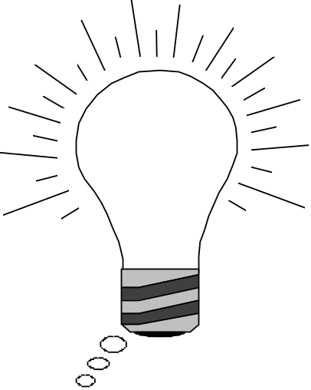

Object Modeling in Practice: Brainstorming
“Dada”
Foo
Amount
Amount
CustomerId
CustomerId
Deposit()
Deposit()
Withdraw()
Withdraw()
GetBalance()
GetBalance()
Account
Amount
CustomerId
Deposit()
Is Foo the right name?
Withdraw()
GetBalance()
Notes:
Naming is important!

Slide 34
Object Modeling in Practice: More classes
Account
Amount
Customer
Bank
AccountId
Name
Name
Deposit()
CustomerId
Withdraw()
GetBalance()
1) Find New Classes
2) Review Names, Attributes and Methods

Slide 35
Object Modeling in Practice: Associations
Account
?
*
Amount
*
Customer
Bank
has
AccountId
owns
2
Name
Name
Deposit()
CustomerId
Withdraw()
GetBalance()
1) Find New Classes
2) Review Names, Attributes and Methods
3) Find Associations between Classes
4) Label the generic associations
5) Determine the multiplicity of the associations
6) Review associations

Slide 36
Practice Object Modeling: Find Taxonomies
Account
Bank
Customer
*
*
Amount
Name
Has
Name
AccountId
CustomerId
Deposit()
Withdraw()
GetBalance()
CustomerId()
Savings
Account
Checking
Account
Mortgage
Account
Withdraw()
Withdraw()
Withdraw()

Slide 37
Practice Object Modeling: Simplify, Organize
Account
Show Taxonomies
separately
Amount
AccountId
Deposit()
Withdraw()
GetBalance()
Savings
Account
Checking
Account
Mortgage
Account
Withdraw()
Withdraw()
Withdraw()

Slide 38
Exercise: Class diagrams
Draw a class diagram for a SimpleWatch that has 2 push buttons to set the time, a LCD display to view the time, has a battery, and shows current time.

Slide 39
Exercise: Class diagrams
Association
Class
Multiplicity
SimpleWatch
1
1
1
1
2
1
1
1
PushButton
Display
Battery
Time
Class diagrams represent the structure of the system

Slide 40
Exercise: Class diagrams
Class diagrams represent the structure of the system
Association
Class
Multiplicity
Watch
1
1
1
1
2
1
1
1
PushButton
state
LCDDisplay
Battery
Load
Time
Now
push()
release()
blinkIdx
blinkSeconds()
blinkMinutes()
blinkHours()
stopBlinking()
referesh()
Attribute
Operations

